Slide 1

Recycle Sorter
Presented by: Ottabotics

Slide 2
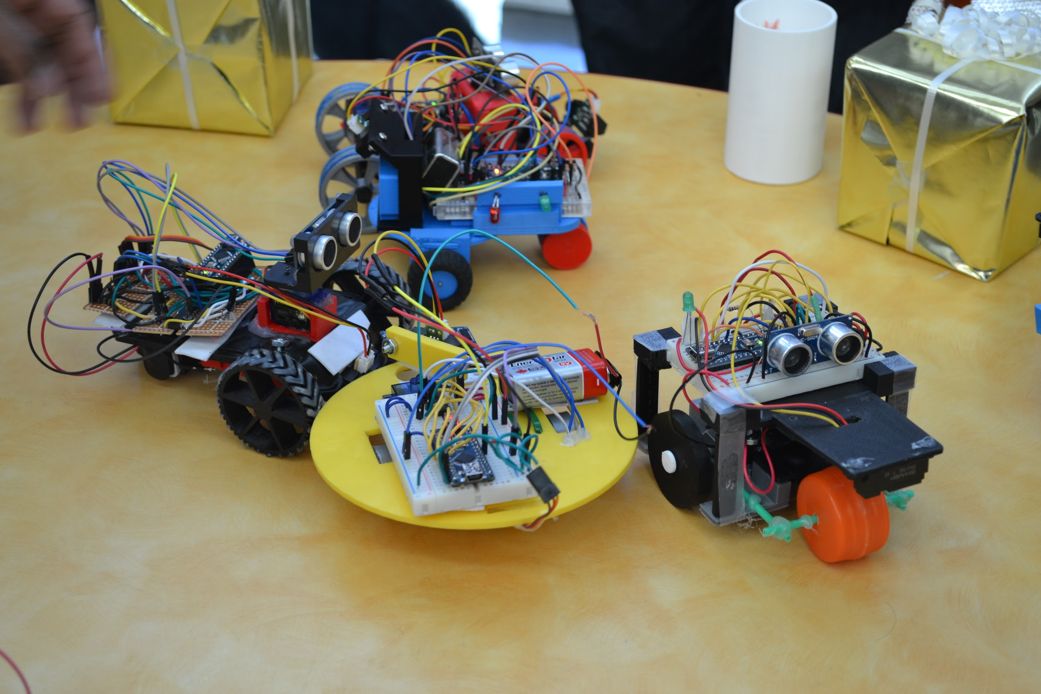
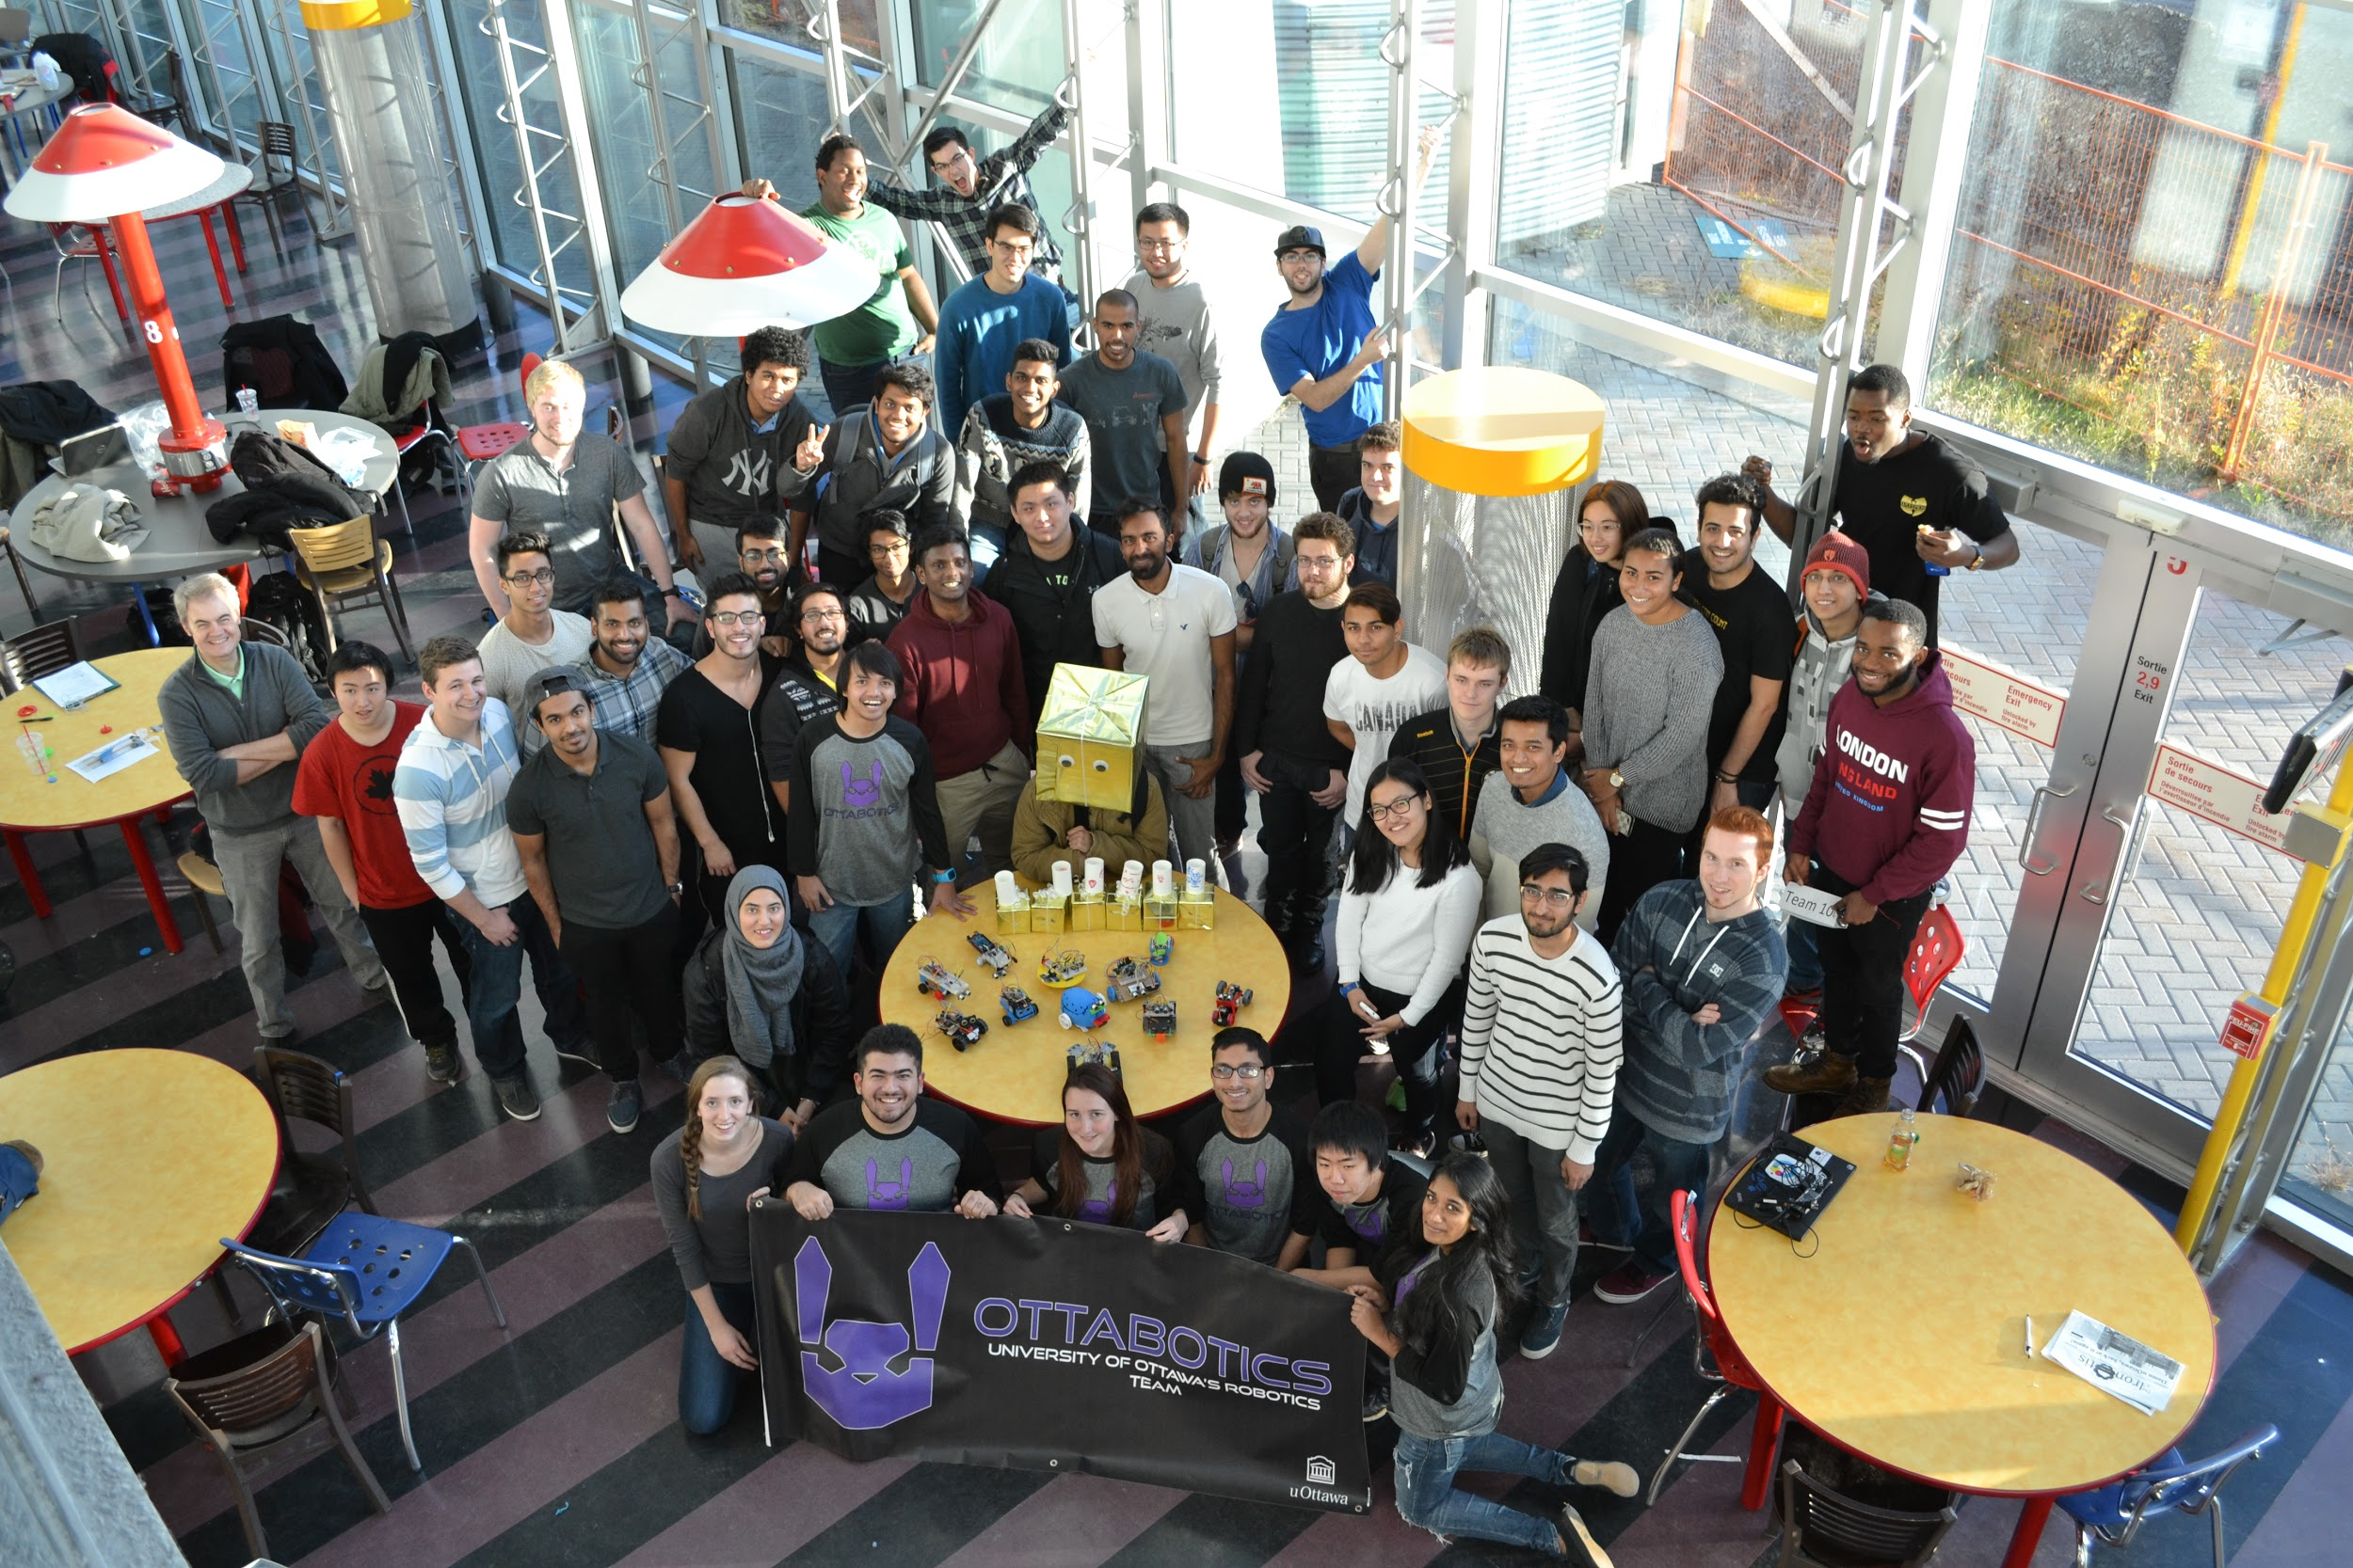
Who are we?
uOttawa’s one and only Robotics team
70 active club members
http://ottabotics.com/

Slide 3
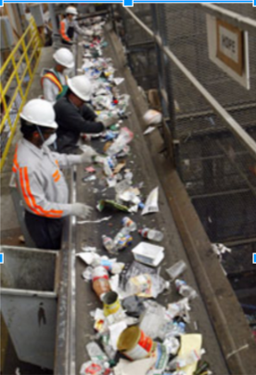
What is the Recycle Sorter?
Sort items before they enter a sorting facility
Plastic and metal can be brought to the appropriate facilities
Less recycle and trash will be mixed together
Improve our school's ability to produce recycle
Useful to many schools, restaurants and outside organizations
Plan to make Recycle Sorter fit on existing all-in-one bins on campus which include metal cans, bottles, trash and compost bins

Slide 4
Features
Uses sensors that can differentiate between metal cans, plastic bottles, paper and possibly compost.
IOT capabilities such as LCD screen and website
To check if a bin is full and needs to be replaced
To show live statistics of how well the organization is using the Sorter

Slide 5
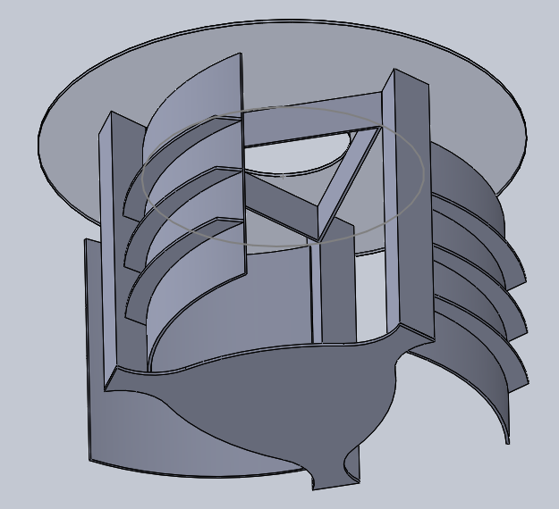
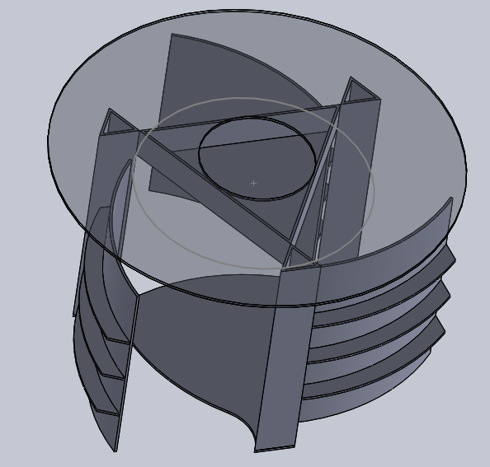
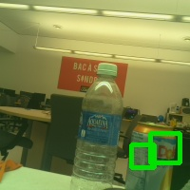
What we’ve accomplished:
Able to detect Water bottles and Aluminum cans
First prototype was 90% completed
Able to integrate Raspberry Pi and Arduino with Servos
Fabricated materials with Laser cutting & 3D printing
Incorporated for a medium circular sized trash can
Must make second prototype

Slide 6

Timeline
January 12th - February 26th
Develop new design for school trashcans
CAD
Sensors Analytics
Programming XML files
Able to reduce costs from testing
Recruiting new members for the project
February 27th - April 2th
Fabrication of design (laser cutting, 3D printing, Brunsfield)
Moving Mechanism
LCD screen
Website for IOT data
Wifi capabilities
April 3rd - June 16th
Testing and modifications
June 16th - August 1st
Field testing

Slide 7
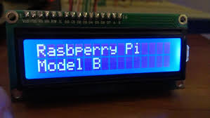
Summary of Costs
Sensors - $500
(multiple: infrared, ultrasonic, mic, photoresistors, hall effect, camera, etc. )
Motors and other actuators - $700
Electrical components - $500
(pcbs, microcontroller, wires, wifi adapter, LCD screen etc.)
Building materials - $400
(Acrylic, metal, wood)
Website and unexpected costs - $100
(Domain and hosting service)

Slide 8
Outreach ideas
We would like to participate in the sustainability fair at the school
We plan to contact:
School newspapers
The community
The City of Ottawa
Environmental and sustainability groups on campus
and promote our project at
uOttawa’s engineering “Design Day” competition
Ottawa Makerfaire 2017
Our successful outcome would be our school or other organizations contributing more recycle

